Slide 1
LESSON 1: How was the Population Exchange justified at Lausanne?
In this lesson, you will…
Consider how ‘peace’ can be defined.
Study the ideas put forward at Lausanne, identifying ways in which the delegates suggested that peace could be secured.
Link the ideas put forward at Lausanne with information about the context of the time.
So that you can…
Complete two flow diagrams, explaining the link between contextual factors, notions of ‘peace’, and events in 1923.
Key words: peace, nationalism, sovereignty, homeland.

Slide 2
In the next three lessons, we’re going to study the Population Exchange of 1923 by looking at different types of sources. This lesson, we’re going to focus on extracts from the diplomatic discussions that took place at Lausanne.
First, let’s re-cap some of the key information about the Population Exchange…

Slide 3
TASK: In your pair, can you answer the following questions?
What was the context for the Population Exchange? (When was it agreed on, and by whom? What was the idea behind it?)
How was the Exchange carried out? (Who organised it? How did it work in practice?)
What were the consequences of the Exchange? (How did people react to it? What impact did it have in the following years? Are the consequences still felt today?)

Slide 4
TASK: To help recall key information about the Population Exchange, complete the ‘Think Link’ grid on the next slide. In your pair, take it in turns to select any two (or three) of the boxes, and explain how they link together to describe reasons for the Exchange; how it was carried out; or its consequences.
After the First World War, the Treaty of Lausanne was negotiated to settle conflict over former Ottoman Empire territories; one issue discussed at Lausanne was the Population Exchange.
First World War
+
Lausanne
=

Slide 5
Lausanne | Armenians | First World War
Ottoman Empire | League of Nations | Nansen
Turkey | Venizelos | ‘Ghost towns’
Refugee Commission | Abandoned houses | Naturalisation
Muslims | Kemal | Orthodox Christians
+
=
?
Box 1
Box 2
What is the link?

Slide 6
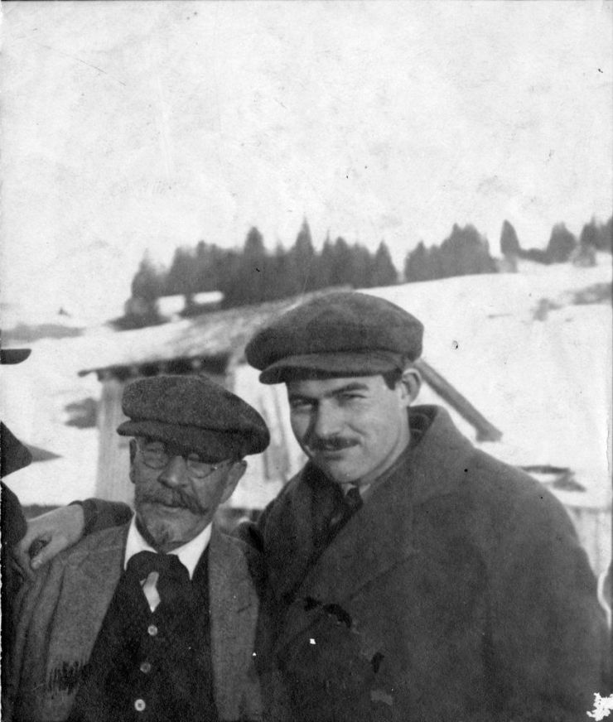
In 1923, American author Ernest Hemingway wrote a poem about the Lausanne Conference. The previous year, he had spent time in Istanbul and Lausanne, reporting on events for the Toronto Star (a Canadian newspaper). Hemingway’s poem – describing events at Lausanne – was called ‘They All Made Peace – What Is Peace?’
If you had to define ‘peace’, how would you do it? Can you agree on a definition with your partner?
Hemingway (on the right) pictured at Lausanne with another journalist.

Slide 7
TASK: Look at the possible definitions or aspects of ‘peace’ on the next slide. In your pair, can you agree on your top three? Which are the most important criteria for peace?
Are there any criteria that you would remove, or that you disagree with? Do any of the criteria contradict one another, or do you think they could all ‘exist’ at the same time?

Slide 8
Absence of international conflict (between countries).
Absence of internal conflict (between groups within the country).
Conditions suitable for economic growth.
People feel safe and secure in their own homes.
Country has independence/
sovereignty
(no ‘outside’ interference).
Respect for human rights (freedom of speech/ assembly/vote).
Single-faith community.
A set of international norms/laws that everyone signs up to.
Good relations with other countries.

Slide 9
This lesson, we’re going to consider how delegates at Lausanne strove to create ‘peace’ in the years after World War One.
In the quotes that we will study, the delegates reflected on the Population Exchange as a method by which ‘peace’ could be secured.

Slide 10
TASK: First, agree in your group on the best summary of the quote(s), choosing from the three possible summaries at the bottom of the sheet.
Then, decide which of the criteria for peace are mentioned or discussed in the quote(s), and tick them off on your copy of Worksheet 1.1.
Correct summaries: Ismet-A / Venizelos-B / Hayashi-B / Curzon-C / Nansen-A / Barrère-C / Child-A.

Slide 11
For example…
Look at the quotes from Ismet Pasha.
He talks about the importance of independence (‘Turkish sovereignty’ and ‘the integrity of Turkey’).
He also describes how, historically, Turkey has been ‘dismembered’, which suggests that Ismet wanted to ensure a level of conformity in the future.
Criteria for ‘peace’: | Ismet?
Absence of international conflict (between countries):
Absence of internal conflict (between groups within the country):
Conditions suitable for economic growth:
People feel safe and secure in their own homes:
Country has independence/sovereignty (no ‘outside’ interference): | ✔
Respect for human rights (freedom of speech/ assembly/vote).
Single-faith community. | ✔
A set of international norms/laws that everyone signs up to.
Good relations with other countries:

Slide 12
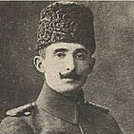
Resource sheet 1.1: Ismet Pasha at Lausanne
‘In making these superhuman sacrifices, the Turkish nation has conquered its place in civilised mankind with all those rights to existence and independence which are inherent in nations capable of a vigorous vitality… The highest aim of the Grand National Assembly of Turkey is to maintain and consolidate this position… Up to the present day Turkish sovereignty had always been infringed on the plea of humanitarian considerations. The integrity of Turkey had frequently been guaranteed by means of promises from the highest authorities and also by solemn treaties, and yet Turkish sovereignty had repeatedly been violated and Turkey had been dismembered again and again. How could Turkey help having misgivings?’
Ismet Pasha
You might also like to consider…
What do you think Ismet Pasha means by ‘civilised’? At another point in the discussion, he described how the Ottoman Empire had been tolerant of non-Muslims for many years. Perhaps he associated ‘civilisation’ with tolerance? Would you agree with his definition?
Which of these summaries best reflects Ismet Pasha’s ideas?
A) Turkey had achieved ‘civilisation’ and wanted to continue making progress. Interference from abroad might compromise this progress. | B) He was concerned to protect the legal and moral rights of minorities living in Turkey. | C) He thought that the Population Exchange might benefit Turkey economically in the long term, helping Turkey progress towards greater ‘civilisation’.

Slide 13
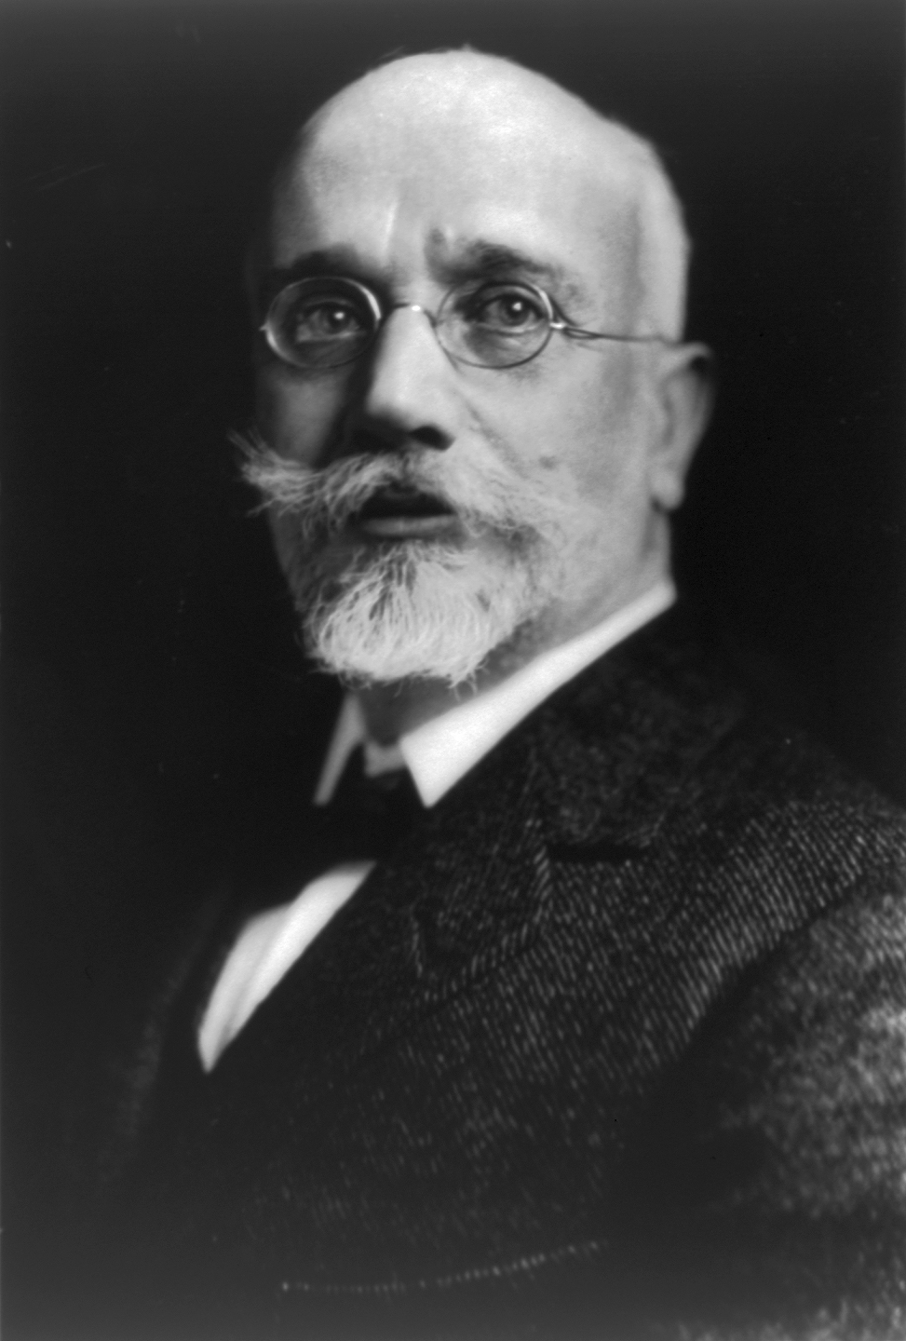
Resource sheet 1.2: Eleftherios Venizelos at Lausanne
‘He [i.e. Venizelos himself] had always held that the only principle which could provide an acceptable solution was that of reciprocal and voluntary emigration. In his great anxiety to facilitate the work of the conference he had gone so far as to accept Dr Nansen’s proposals for a compulsory exchange, but only because he had become firmly convinced that any other settlement of the refugee problem would be rejected by the Ottoman delegation.’
Eleftherios Venizelos
You might also like to consider…
What phrases does Venizelos use as a way of suggesting that the Population Exchange was not his idea? How does he try to distance himself from it?
In reality, it’s difficult to determine who first devised the idea for the Exchange.
Which of these summaries best reflects Eleftherios Venizelos’ ideas?
A) He was proud to have come up with the idea of the Population Exchange as a way of ‘unmixing the population’. | B) He reluctantly agreed to a compulsory Population Exchange, though he thought that a non-compulsory approach would have been better. | C) He thought that the Population Exchange would work on humanitarian grounds, as there were a lot of people ready to volunteer themselves for the Exchange.

Slide 14
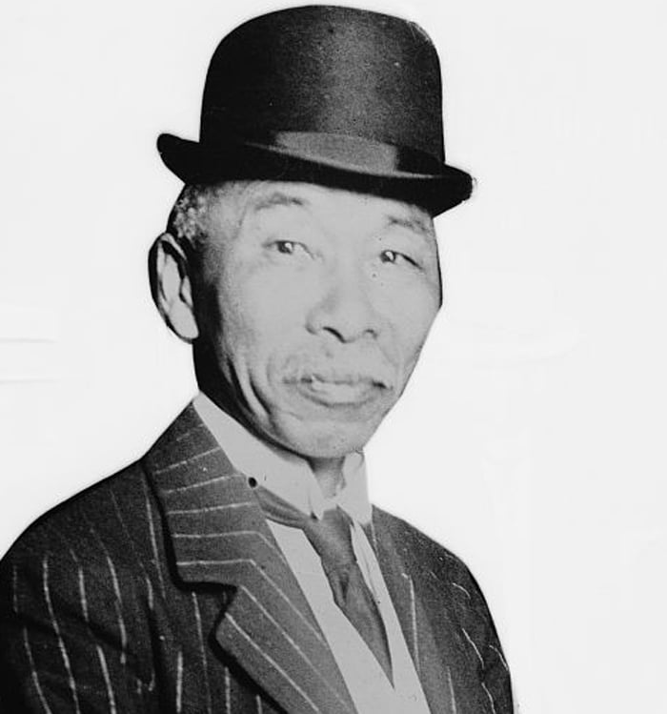
Resource sheet 1.3: Hayashi Gonsuke at Lausanne
‘To my mind, Turkey has secured nearly everything she had hoped for on the most important point, that is, her sovereign power… Turkey will be almost the only Power among our ex-enemies that has come out without loss of prestige and has emerged with a full promise of peaceful development.’
Hayashi Gonsuke
You might also like to consider…
In 1905, Japan became the first ‘non-white’ nation to defeat a European empire, when they overcame Russia in the Russo-Japanese War.
Why do you think Turkish leaders felt they had lessons to learn from Japan’s recent history?
Which of these summaries best reflects Hayashi Gonsuke’s ideas?
A) The disastrous effects of the First World War could only be remedied with a carefully-planned Population Exchange. | B) He thought that Turkey had the potential to be a successful country in the future (unlike the other nations that had been defeated in World War One). | C) Those who proposed the Population Exchange needed to reconsider, as it would cause countries to lose prestige.

Slide 15
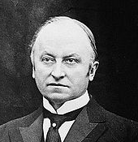
Resource sheet 1.4: George Curzon at Lausanne
‘The purpose of the conference was to make a solution for the future. For his own part, he deeply regretted that any solution now being worked out should be the compulsory exchange of populations – a thoroughly bad and vicious solution, for which the world would pay a heavy penalty for a hundred years to come. He detested having anything to do with it. But to say it was a suggestion of the Greek Government was ridiculous. It was a solution enforced by the action of the Turkish Government in expelling these people from Turkish territory.’
George Curzon
You might also like to consider…
At the end of the First World War, there was ‘war-weariness’ in Britain: a sense that Britain needed to spend less time and taxpayers’ money on its empire. How might this attitude have shaped Curzon’s views?
Which of these summaries best reflects George Curzon’s ideas?
A) He thought that the Population Exchange was the only option left, as countries wished to recover economically after the First World War. | B) He thought that the Population Exchange would provide a good model for future exchanges, despite being difficult to implement. | C) He was opposed to the Population Exchange, and he blamed Turkish leaders for coming up with the idea.

Slide 16
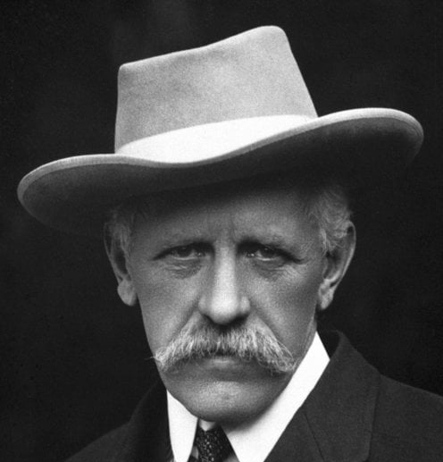
Resource sheet 1.5: Fridtjof Nansen at Lausanne
‘Anyone who has reflected upon what is involved in the displacement of populations of many more than 1,000,000 people, in uprooting these people from their homes, transferring them to a strange new country, in registering, valuing and liquidating their individual property which they abandon, and in securing to them the payment of their just claims to the value of this property, will understand that the difficulties are immense… There had been already very great displacements of populations… Unless something is done, and done quickly, to deal with it, the economic results for both countries… will be disastrous. More can be done by a prompt and efficient exchange of minority populations to prevent these disastrous economic results from coming about than by any other measure which can be taken.’
Fridtjof Nansen
You might also like to consider…
In 1921, Nansen was appointed High Commissioner for Refugees for the League of Nations. In 1922, he was given the Nobel Peace Prize for his work on behalf of those displaced by the First World War. How does the language used in the extract reflect Nansen’s humanitarian approach? Is there anything in the extract that seems to contradict this?
Which of these summaries best reflects Fridtjof Nansen’s ideas?
A) He thought that the quick movement of people back to where they ‘belonged’ was the only way to prevent significant economic problems. | B) He thought that the Population Exchange would be too impractical to actually implement, due to the numbers involved. | C) He wanted to prioritise the ‘human’ needs and wishes of the people involved in the Population Exchange.

Slide 17
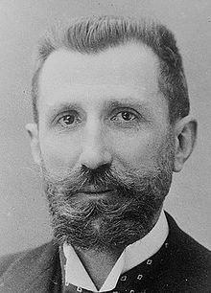
Resource sheet 1.6: Camille Barrère at Lausanne
‘Can we doubt… that Turkey appreciates the true value of the economic and moral strength which she has hitherto derived from these minorities? At a time when commercial, industrial and agricultural activity is so necessary to every country for repairing damages due to a long series of wars and for exploiting undeveloped wealth, can we believe that the Turkish Government will fail to recognise how vitally important it is to preserve certain educated, industrious and hard-working elements of the population?’
Camille Barrère
You might also like to consider…
What evidence does Barrère give of the benefits that Turkey had derived from the ‘minorities’ currently living in Turkey?
Why did some Turks at the time have a different view of these people, and their role in Turkish society?
Which of these summaries best reflects Camille Barrère’s ideas?
A) He was an enthusiastic supporter of the Population Exchange, on humanitarian grounds. | B) He thought that the Population Exchange would do little to solve the deep-rooted economic problems present in Turkey. | C) He suggested that Turkey would do better to keep the minority groups that they wanted to exchange, because these groups were so important to Turkey’s economy.

Slide 18
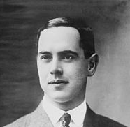
Resource sheet 1.7: Richard Washburn Child at Lausanne
‘The comfort and safety and settlement of the hundreds of thousands of human beings, most of them non-belligerents, many of them women and children, many dislodged for ever from their homes by the disturbances in the near East, is a matter which has for the people of the United States a vital interest… We believed that new precedents which tend to establish the right of nations to expel large bodies of their citizens to become burdens upon other nations must be carefully considered… lest a new and unwholesome principle find foothold to vex international law and justice.’
Richard Washburn Child
You might also like to consider…
Can you identify words or phrases from the extract that highlight Child’s commitment to humanitarianism?
At Lausanne Ismet Pasha pointed to a double standard, noting the poor treatment of minorities in the USA. Which groups do you think he was thinking of?
Which of these summaries best reflects Richard Washburn Child’s ideas?
A) He was worried about the Population Exchange, because he was worried that it might lead to other groups of people being forced to move in the future. | B) He thought that forcing a wave of refugees from their homes could lead to a rise in crime. | C) He supported the Population Exchange as a way of bringing order and security back to the region.

Slide 19
Worksheet 1.1: Recording grid
Criteria for ‘peace’: | Ismet? | Venizelos? | Hayashi? | Curzon? | Nansen? | Barrère? | Child?
Absence of international conflict (between countries):
Absence of internal conflict (between groups within the country):
Conditions suitable for economic growth:
People feel safe and secure in their own homes:
Country has independence/ sovereignty (no ‘outside’ interference):
Respect for human rights (freedom of speech/ assembly/vote).
Single-faith community.
A set of international norms/laws that everyone signs up to.
Good relations with other countries:
Did any of the delegates mention or describe any other criteria for ‘peace’? Note them down here:
Which criteria were mentioned most commonly? Did this surprise you? Explain your ideas:

Slide 20
Now, it’s time to think about the context in which these definitions or ideas about ‘peace’ (and an understanding that the Population Exchange might help to secure it) came into being.
TASK: In your group, reflect on each of the context cards in turn. Can you link any of these cards with the ideas expressed by the delegates at Lausanne? Use the sentence starters on the next slide to help you…

Slide 21
[Event/development] helped to inspire [individual’s] ideas because…
[Event/development] made it more likely that [individual] would argue… because…
It was in the context of [event/ development] that people were starting to think that…
There was a link/relationship between [event/development] and… because…

Slide 22

Resource sheet 1.8: Context cards
Context card A: ‘Nationalism’ is the idea that a group of people share a particular identity, a language and a ‘homeland’ – and that these people should therefore be able to govern themselves, free from interference. Nationalism began to develop in the 18th and 19th centuries, when some people began to consider themselves part of a ‘nation’ for the first time. As part of this new thinking, there were calls to ‘unmix’ populations, with some groups identified as not fitting in. | Context card B: The First World War caused huge problems in Europe and beyond, as many countries’ economies struggled to recover from the effects of the conflict. The main powers involved in the war faced huge debts, and the political unrest caused by the war (in countries like Germany, Italy, Russia, Greece and the Ottoman Empire/Turkey) led to further economic uncertainty.
Context card C: The First World War helped to bring about the collapse of four major empires: the German, Russian, Austro-Hungarian and Ottoman Empires. Although the British and French empires remained intact, there were calls for the imperial system to be reformed – or even abolished. Some felt that empires were not suitable for the ‘modern’ world, because there were no real ties holding the peoples of huge empires together. These people were inspired by new ideas of the ‘nation’ to argue that ‘modern’ communities should be based on shared ethnic, religious or cultural identities. | Context card D: The League of Nations was established at the Paris Peace Conference in January 1920. Aiming to maintain world peace, the League’s founding members agreed that international disputes needed to be settled through negotiation and arbitration. The first four non-permanent members of the League (Britain, France, Italy and Japan) were immediately joined by four non-permanent members – one of which was Greece. Turkey did not join the League until 1932.

Slide 23
Now, let’s reflect on the chain of events that led to the decision to enact the Population Exchange.
TASK: Complete the two flow diagrams: for each one, describe the impact of a contextual factor on the specific definitions or notions of peace expressed by one or more of the delegates at Lausanne. Then, explain how these ideas, in turn, influenced the delegate(s) to recommend (or reject) the idea of the Population Exchange.

Slide 24
For example…
Contextual factor(s):
Ideas about the Population Exchange:
Notions of ‘peace’:
Developing ideas about nationalism led some leaders to call for people and populations to be ‘sorted out’…
This meant that…
In practice, this might involve…
These ideas might have influenced the ideas of people like Ismet Pasha, who defined ‘peace’ as…
Ismet Pasha’s ideas about ‘peace’ encouraged him to support the idea of the Population Exchange, because…

Slide 25
Worksheet 1.2: Flow diagrams
Contextual factor(s):
Ideas about the Population Exchange:
Notions of ‘peace’:
Contextual factor(s):
Ideas about the Population Exchange:
Notions of ‘peace’:

Slide 26
END TASK: Reflect on the statements on the next three slides. How far do you agree with them?
Discuss your ideas with your partner. Decide where you would place your mark on the continuums, offering justifications.

Slide 27
‘There was generally a high level of agreement at Lausanne over what ‘peace’ might look like.’
Strongly agree
Somewhat agree
Neutral
Somewhat disagree
Strongly disagree

Slide 28
‘The rise of nationalist ideas best explains why the Population Exchange was proposed as a solution in the 1920s.’
Strongly agree
Somewhat agree
Neutral
Somewhat disagree
Strongly disagree

Slide 29
‘Diplomats at Lausanne took pride in having invented a new peace-making solution.’
Strongly agree
Somewhat agree
Neutral
Somewhat disagree
Strongly disagree

