Slide 1
LESSON 3: How valuable are the objects owned by displaced peoples as historical sources?
In this lesson, you will…
Consider what objects you might take, if you were forced to leave your home suddenly.
Study some of the objects taken by displaced peoples in the wake of the Population Exchange, making inferences about their owners and speculating about why the objects were taken.
So that you can…
Reflect on the value of the objects as historical sources.
Write an ‘it-narrative’ from the perspective of a chosen object.
Key words: value, corroborate, challenge.

Slide 2
You return to your house after school, with plenty to tell your family about the day you’ve just had. However, you immediately pick up on an atmosphere of anxiety. What’s going on? Why is everyone running frantically around the house?
Your parents finally calm down enough to tell you that the whole family is being forced out: you must leave your home in two weeks’ time.
You are being moved to a new country, and you will not be able to return. Your parents tell you to pack a bag: you must choose only the three items that mean the most to you, and that you cannot bear to leave behind.

Slide 3
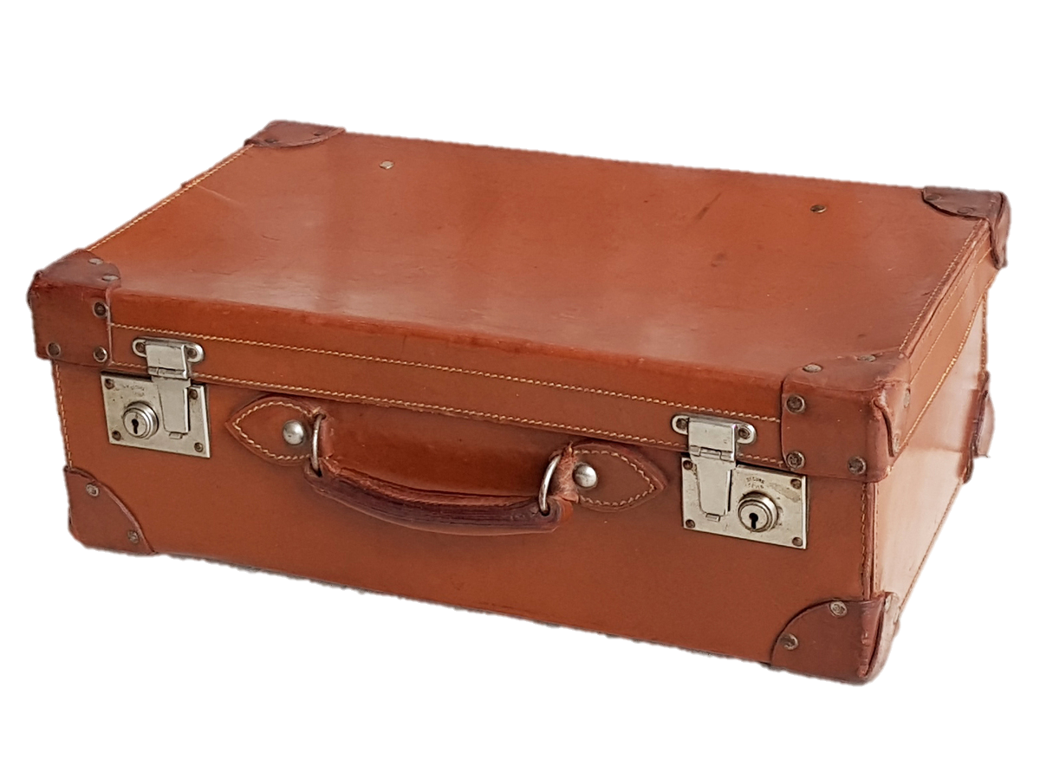
TASK: Discuss your ideas in your pair: what three items would you take with you? Bear in mind…
Your phone doesn’t count as one of your three items (you can carry this in your pocket!).
You have one small bag/case to carry your items: they must fit inside.
You might want to think about practical items (things that might be useful in your new life), as well as sentimental ones (things that will help you remember your old life).

Slide 4
The scenario in which you have just placed yourself is is, in essence, the same as that in which those involved in the Population Exchange found themselves.
The families selected to take part in the Exchange were given a limited amount of time (perhaps a couple of days, or a few weeks) to pack up their belongings and get ready to move.

Slide 5
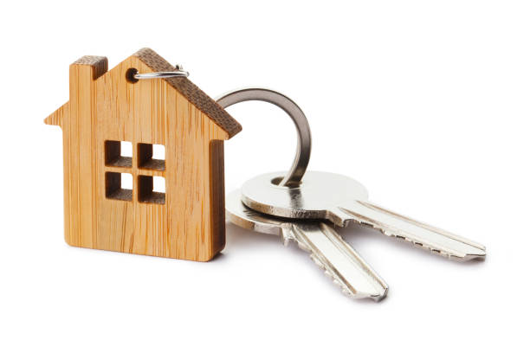
With little prospect of returning, those involved in the Exchange also had to decide what to do with the items they planned to leave behind.
TASK: Discuss your ideas: what would you do with the things that you were unable to take with you? Would you simply leave them where they were, knowing that they would probably be removed, stolen or left to rot? Would you give them to someone else? Would you destroy them?
What would you do with your house keys?

Slide 6
Now, we’re going to look at the objects that were taken by some of these displaced peoples.
TASK: In your group, study your first object card. Without revealing the information on the back, discuss the object and its significance. Consider its purpose, and any inferences you can make from the object about its owner. Then, speculate about the reasons why the object was taken. The next slide might give you some ideas…

Slide 7
When discussing the objects, consider these points…
What can we infer about the original owner(s)?
How old might they have been at the time of the Exchange?
What jobs might they have had? What role did they play in society before the Exchange?
What might their hobbies/passions have been?
Are they likely to have been wealthy, or less well-off?
Why do you think it was taken?
Did the object serve a practical purpose? What could it be used for?
Might the object have been of sentimental value?
Would the owner(s) have been able to use the object in the same way in their new home as they had done in their old home?
Why could the owner(s) not bear to leave the object behind?

Slide 8
Worksheet 3.1: Recording grid
What is the object, and what was its purpose? | What can we infer about the original owner(s)? | Why do you think it was taken?
What is the object’s value as an historical source?

Slide 9
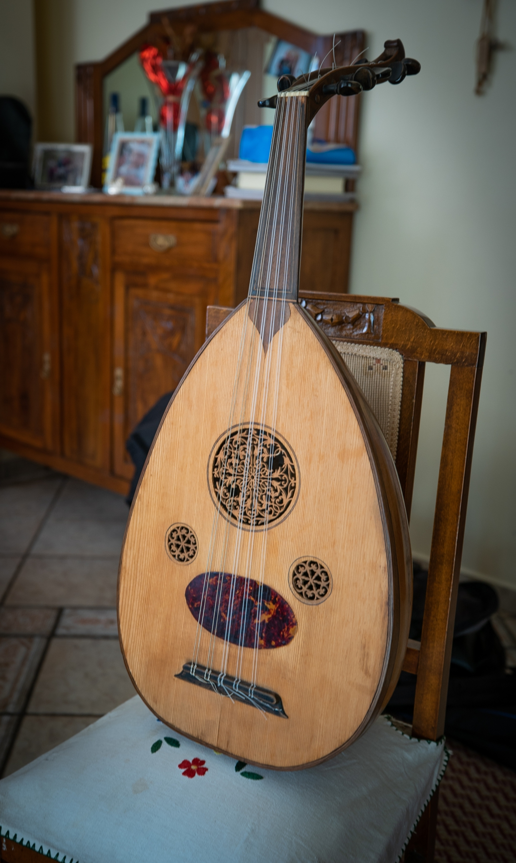
Resource sheet 3.1a: Object 1
An oudh

Slide 10
Resource sheet 3.1b: Object 1
An oudh:
Vasilis Kaptanoglou was born in Prokopi, Cappadocia, in 1907. Vasilis and his mother reached Piraeus at the beginning of 1921 and settled in the makeshift refugee settlement of Tampouria before the majority of the refugees arrived. Throughout his life, he never stopped playing the oudh, the same one he brought with him from Prokopi.

Slide 11
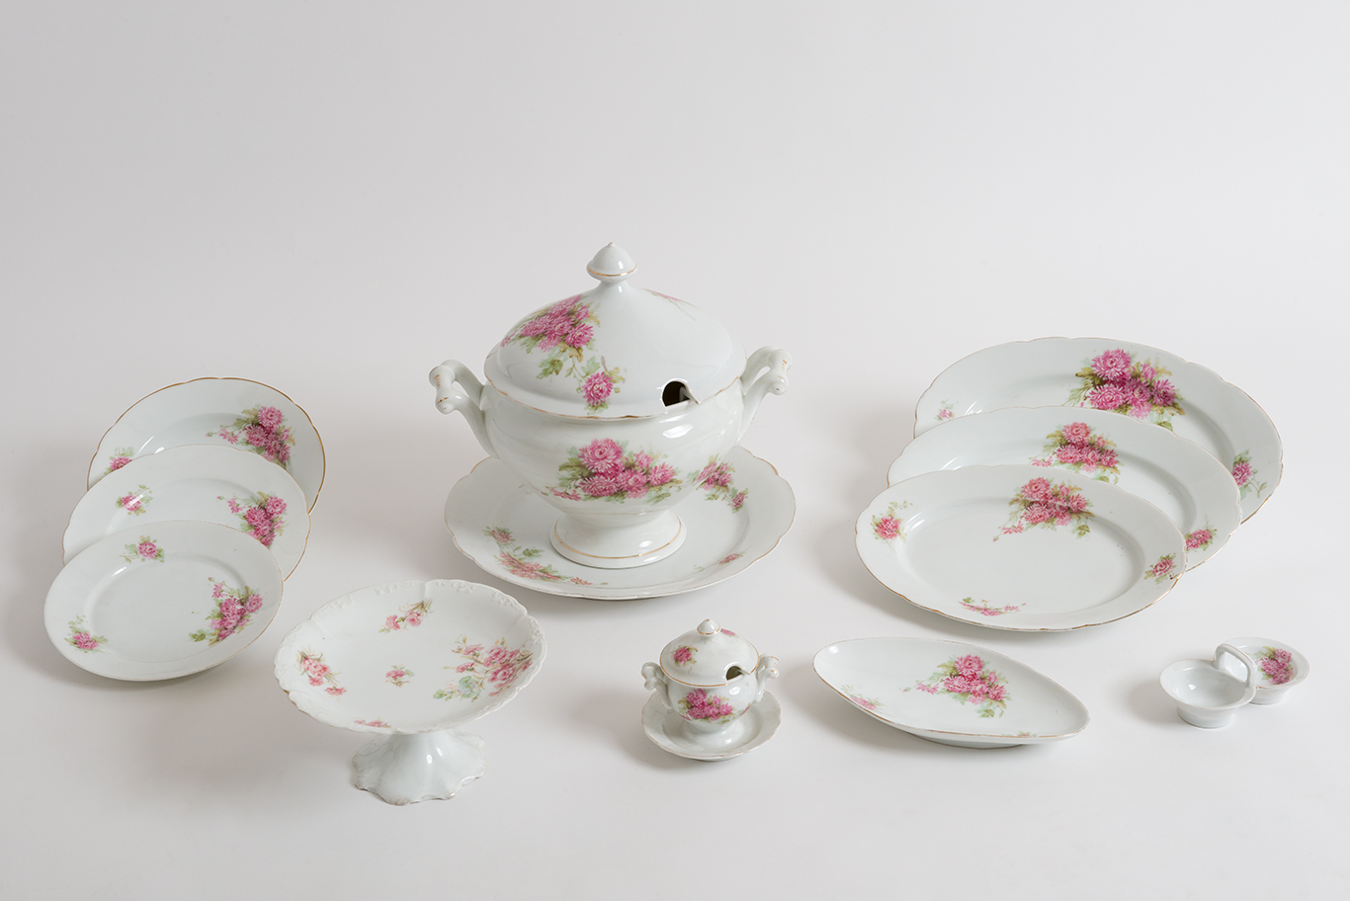
Resource sheet 3.2a: Object 2
A dinner set

Slide 12
Resource sheet 3.2b: Object 2
A dinner set:
The set was made in Bavaria and bought by Panaretos Kaltsa in Constantinople. It was a gift for his wife Foteini who wanted a china set so that she could throw dinner parties just like her friends. It is uniquely decorated with a chrysanthemum pattern, while most china sets of the time were adorned with roses. It comprised 24 plates, 24 site plates, 24 plates for fruit, a soup tureen, platters and other pieces. It was one of the few possessions that Foteini chose to take with her when they life Silyvria (Silivri) for Greece.

Slide 13
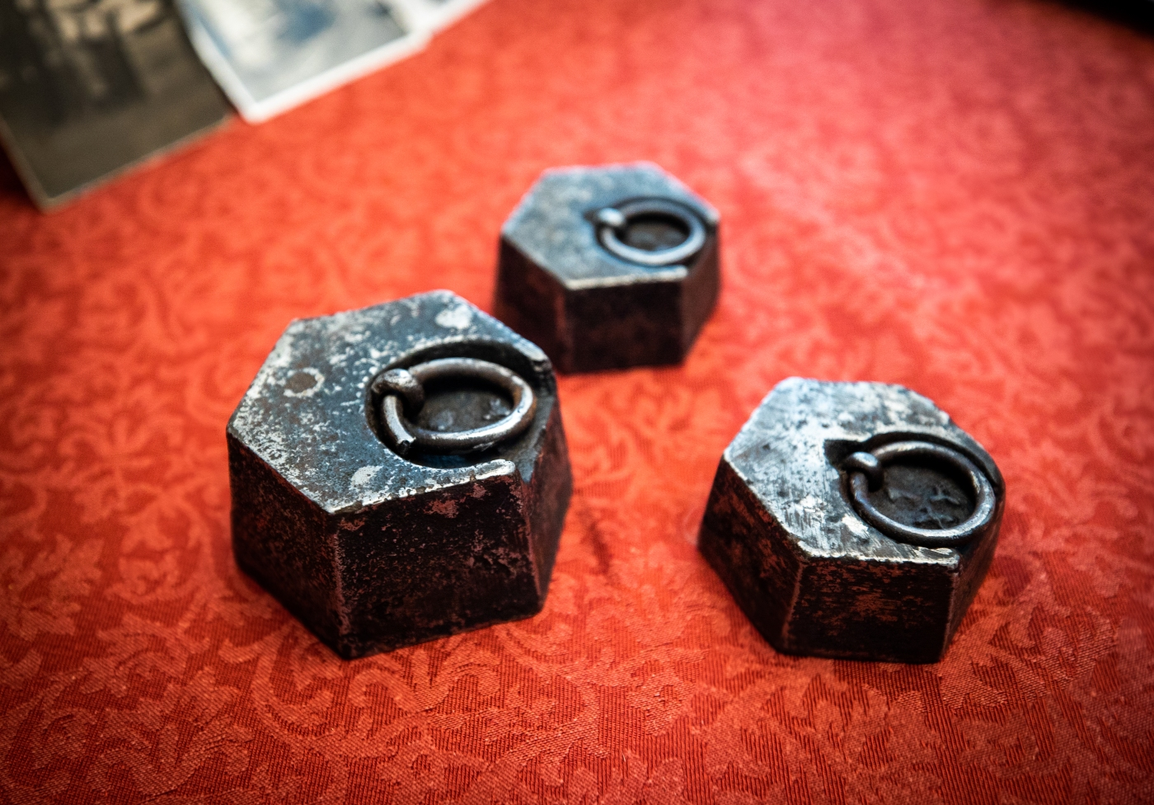
Resource sheet 3.3a: Object 3
A set of weights

Slide 14
Resource sheet 3.3b: Object 3
A set of weights:
From grocery store owner at Vatum (Batumi), Pontus, to travelling greengrocer in Piraeus, Georgios Tsouchnikas and his family became refugees twice, both times carrying along their few possessions. Among them were his scale weights: important work tools, but also reminders of the shop he left behind and proof of his hope that he would be using them again in his new life.

Slide 15
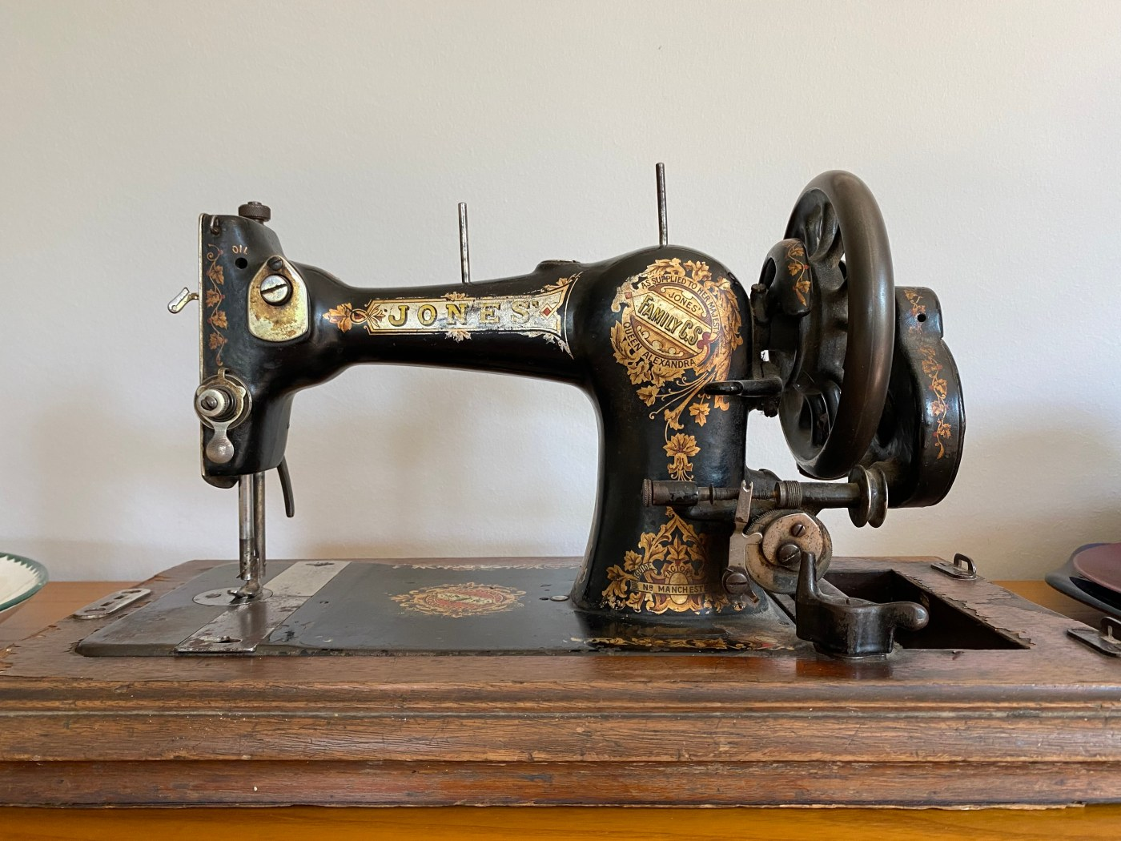
Resource sheet 3.4a: Object 4
A sewing machine

Slide 16
Resource sheet 3.4b: Object 4
A sewing machine:
Anastasia Michailidou spent her whole life fleeing; from Pontus to Russia and from there, to Greece; to Argos, to Katerini, to Thessaloniki and then to Nikaia, in Piraeus. Two World Wars, one revolution and years of constant movement in search of safety and stability for herself and her family. A Singer sewing machine, a samovar and some black caviar were all the belongings she brought with her.

Slide 17
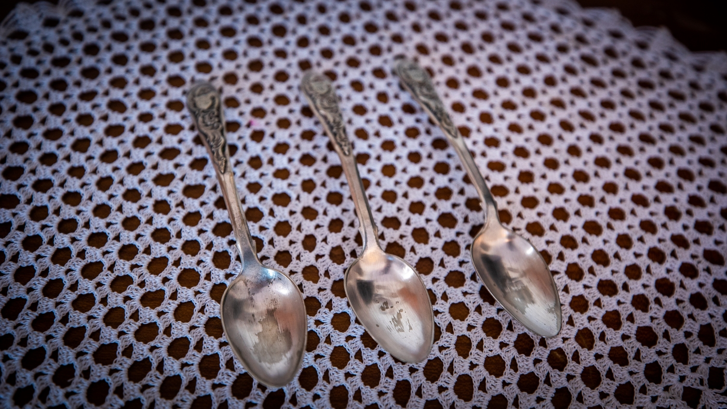
Resource sheet 3.5a: Object 5
Dessert spoons

Slide 18
Resource sheet 3.5b: Object 5
Dessert spoons:
Charoula Panagiotidou has kept some of the objects brought to Greece by her mother’s family: a set of six, hefty, silver-plated spoons and forks which have been used for years in her household and three intricate silver dessert spoons engraved with the initials ‘P.Th.’, standing for ‘Pinelopi’ and ‘Theofilos’, probably given to Charoula’s grandparents as wedding gifts. She still uses all these objects in her everyday life and shares their stories with her children and grandchildren in an effort to keep the history of the family alive and preserve the memory of the house, the village, and the life they left behind.

Slide 19
Now, we’re going to reflect on the value of objects as historical sources.
All sources are valuable/useful for one reason or another. However, one of the ways we can quantify this value is by considering two criteria…
…How does the information/insight provided by the source corroborate (back-up/support) other sources, or what I know already?
…How does the information/insight provided by the source challenge (or offer alternative views about) other sources, or what I know already?

Slide 20
Let’s practise this by reflecting on the objects you chose to take with you on your imaginary journeys at the beginning of the lesson.
TASK: In your pair, take it in turns to tell each other the three objects you selected. Then, carry out an analysis of the objects (and your partner!) using the criteria outlined below:
What were your partner’s three chosen objects?
How do these choices corroborate what you already know about your partner?
How do these choices challenge what you know, or give you new insight into their character?

Slide 21
For example…
What were your partner’s three chosen objects?
How do these choices corroborate what you already know about your partner?
How do these choices challenge what you know, or give you new insight into their character?
‘This confirms what I know about my partner: that they love to play football. I see them playing football every day. I’m not surprised they need the cooling gel: they’ve probably caused an injury playing too often.’
‘My partner chose to take a football, a tube of medical cooling gel, and a decorated biscuit tin (which they tell me was inherited from a relative who passed away).’
‘This gives me new insight into my partner, because I didn’t know that they had lost a relative. It makes me think that they have more of an emotional side than I had realised.’

Slide 22
TASK: Now, follow the same process for the five objects taken by the displaced peoples in the 1920s. Use the two criteria below to help you complete the final column of your grid.
…How does the information/insight provided by the source corroborate (back-up/support) other sources, or what I know about the Population Exchange already?
…How does the information/insight provided by the source challenge (or offer alternative views about) other sources, or what I know about the Population Exchange already?

Slide 23
If objects could talk, what would they say?
END TASK: Choose one of the objects you have studied this lesson – or you could visit the ‘100 Objects’ gallery on the website for The Lausanne Project, and select one from there. You are going to write an ‘it-narrative’ from the perspective of your chosen object…

Slide 24
Writing your it-narrative:
Write from the first-person perspective (‘I saw…’).
Your narrator (the object) can have thoughts and feelings, too… strange as that might sound! How might the object have ‘felt’ about the journey it was taken on?
The object might ‘see’ things from a particular physical perspective: for example, it might have been kept inside a bag for most of its journey. What might it have seen and felt when it first arrived at its destination?
What kind of ‘personality’ might your object have?
With whom might it have felt sympathy on the journey? What might it have ‘missed’ or regretted?

Slide 25
For example…
‘What an anxious time I’ve been through!
The bumps on the journey were scary and
I thought I might break into pieces.
Where once I was played by light, nimble
fingers, now my sound is mournful, my strings plucked with tense fingers.
At first, I was so relieved to have been brought here – to have been chosen to join my family in their new life when so much else was left behind. But now, I wonder whether it might have been better to remain, after all…’

Slide 26
Worksheet 3.2: It-narrative template
Use this space to write your it-narrative:
______________________________________________________________
______________________________________________________________
______________________________________________________________
______________________________________________________________
______________________________________________________________
______________________________________________________________
______________________________________________________________
______________________________________________________________
______________________________________________________________
______________________________________________________________
______________________________________________________________
______________________________________________________________
______________________________________________________________
______________________________________________________________
______________________________________________________________
______________________________________________________________
______________________________________________________________
______________________________________________________________
Your chosen object:
Draw a quick illustration of the object:
You could write about:
What ‘you’ (the object) were used for before your family (the object’s owners) were forced to move.
The atmosphere/feelings you picked up on, when your family found out about the Exchange.
The process your family went through in packing up their lives.
The journey undertaken by your family.
The new life that faced you and your family.

Slide 27
Does your family have any Exchange objects of their own? Would you/they like to include it in the ‘100 Objects’ gallery on The Lausanne Project website?
If several members of the class have these objects, you could spend some time discussing them – and writing 100-word summaries to accompany the image on the website.

